Slide 1
Introduction to higher education
Cass Business School
Accounting and Finance
Actuarial Science
Banking and International Finance
Finance
Investment and Financial Risk Management
Business Management (5 pathways)
School of Mathematics, Computer Science and Engineering
Aeronautical Engineering
Biomedical Engineering Civil Engineering Electrical Engineering
Engineering Mechanical Engineering
Structural Engineering
Business Computing Systems
Computer Science (3 pathways)
Data Science
Mathematics (3 pathways)
Schools of Arts and Social Sciences
Criminology (3 pathways)
Sociology (3 pathways)
Psychology (3 pathways)
Media, Communication and Sociology
Economics (3 pathways)
International Politics (4 pathways)
History
English
Journalism
Music (2 pathways)
City Law School
Law
School of Health Sciences
Adult Nursing
Child Nursing
Mental Health Nursing
Midwifery
Health and Social Care
Optometry
Diagnostic Radiography
Radiotherapy and Oncology
Speech and Language (2 pathways
Kat Knight
UK Marketing and Recruitment Officer

Slide 2
What is Higher Education?
Higher Education is an ‘umbrella’ term for institutions who offer qualifications which provide learning in a more specific context and on a higher level than A-levels
Higher Education is not only offered at university – some colleges also offer higher education courses

Slide 3
Timeline to apply
Year 12 is about researching universities and courses. Attend open days and taster days to help you make the right decision
The application form for university is online on a website called UCAS. Students complete this with support from school
Apply by 15th October for Medicine, Dentistry and Oxbridge
Apply by 15th January for most other courses

Slide 4
How UCAS works
Most of the application form is similar to a job application
On the form they will need to select up to 5 choices. This can be 5 different universities for the same course, or sometimes slightly different courses at the same university as some of their 5 spaces
They will be considered by the universities based on entry requirements
The university will then hopefully offer the student a place
They then select their firm (top) choice and insurance (back up) choice

Slide 5
A day in the life of a student
09:00 Lecture
10:00 Labs
11:00 Personal Tutor meeting
11:30 Society/sport
13:00 Lunch
14:00 Off to work
17:01 Back home
18:00 Dinner
19:00 Off to town!
23:00 Back to bed

Slide 6
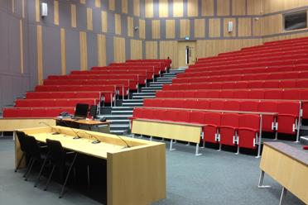
9:00 Lecture

Slide 7
Choosing a Course / University
There are around 35,000 courses and 370 higher education providers to choose from in the UK, so you need to try and narrow down what you are looking for from a university and course
Of these 35,000 courses you can choose five
Remember that ruling out what you don't like is as important as thinking about what you do like

Slide 8
Choosing a course
Study a subject you love
Meet other people who share your interest
Learn from leading professionals in the field you are interested in
Undertake your own research and make an impact
Do you really know what the course is about?

Slide 9
Choosing a course
There are so many more courses available at university than there are at college. Make sure you really look to see what is out there.
Why not try ...
Social Anthropology
Food and Consumer Science
Instrumental Teaching
Adventure Media
Clinical Photography
Biosciences
Entertainment and Media Law
Community Sport Management
Sports Journalism
Linguistics
Marine Photography
Microbiology
Football Business and Media
Media, Culture and Society
Middle Eastern Studies
Urban and Contemporary Music
American Literature

Slide 10
Choosing a course
Even within one subject area there is a lot of choice
Computer Visualisation and Animation
Games Design
Computing
Animation
Computing and Systems Development
Computer Arts
Computer Science
Web Design and Software Development
Computing with Accounting and Finance
Computer Games Art
Computer Games Technology
Information and Interface Design
Business Information Technology
Computer Systems Engineering
Computer Graphics, Vision and Games
Computer Forensics
Computer Science for Cyber Security
Independent Games Production

Slide 11
10:00 Lab
Many courses will have practical sessions which enhance your learning
These can be in areas like labs and simulated suites
Courses which don’t have lab sessions may have other types of sessions like seminars (small group conversation)

Slide 12
Things to consider
Assessment style - exams, practicals
Teaching hours - some universities have teaching hours as little as 8 hours a week. For some it is much more
Optional Modules - if you want to be able to mix and match your course, make sure you look into this
Placement opportunities - some universities offer placements abroad, or you may be able to go on work placement
Common first years – allow you to swap onto different pathways

Slide 13
11:00 Personal Tutor meeting
Check your progress
To help you stay on track
To discuss any academic issues or challenges you are facing
To raise any personal issues which may be affecting your work
To have conversations to help you choose modules/research topics

Slide 14
11:30 Society/Sport

Slide 15
What are the benefits of Higher Education?
Life Experience
Gain independence - learn to live independently and manage your finances
Take control of what you learn - undertake research in areas you are interested in in preparation for your future
Meet new people from all over the world and learn about their cultures
Have fun - get involved in social activities to develop your skills

Slide 16
What are the benefits of Higher Education?
The 12 Weirdest University Societies
Hummus society, LSE
Harry Potter and Gin society, St Andrews
Society for Gentlemanly Pursuits, Keele University
PunSoc, University of Sussex
Lemon Fanta Society, University of York
Custard Wrestling Society, Cardiff University
Human Vs Zombies Society, University of Birmingham
Pokémon Society, University of Westminster
Pirate Society, University of Sussex
Bell Ringers Society, University of Nottingham
Tudor Society, University of Kent
LipDub Society, University of Bristol

Slide 17
1:00 Lunch
Your university will have places to eat and socialise
There may be areas around the university you can eat – especially if your university is in a town or city

Slide 18
2:00 Off to work

Slide 19
What are the benefits of Higher Education?
Jobs
For some vocational careers like teaching and medicine, you cannot work in that field without a degree
Having a degree opens up more job opportunities so you can potentially enter more professions
Look for accredited degrees if needed e.g. Psychology to ensure you get the professional qualification you need to work in that field

Slide 20
What are the benefits of Higher Education?
Money
Graduate salaries are on average around £30,000 a year (HighFliers)
The 'Top 100 Graduate Employers' in particular are offering high starting salaries, with Aldi offering £42,000 to graduates
There is usually more chance of promotion with a degree

Slide 21
Year in industry
Professional experience
Networking
Taste of the working world
Compliment your learning
Is that career right for you?
Job prospects
Increase your starting salary

Slide 22
Other work opportunities
Part time jobs
University recruitment agencies
Student only
Flexible hours
Part time jobs across campus
Volunteering
London on your doorstep!

Slide 23
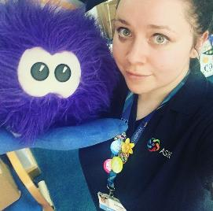
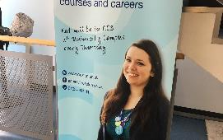
My journey
Degree – Musical Theatre
Alongside my degree
Fresher’s Week
Student Ambassador
Gave talks at schools
Was asked to apply for a job at my university
Was offered a graduate scheme
Took over UCAS applications – 3 years
Changed sectors and moved to City

Slide 24
7:00 Off to town!

Slide 25
Location
How far away from home would you like to be?
Things to consider
Consider transport links from home to the University
Look up how much transport costs – some train tickets will be too expensive to buy on the day if you decide last minute you want to pop home
If you plan to take your car with you, make sure you check if the University will allow this as they don’t always
Consider all transport options e.g. train, coach, bus, aeroplane
Look into discounts such as 16-25 railcard which reduce the cost of travel

Slide 26
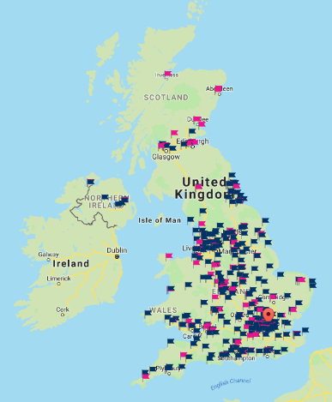
Location
https://universitycompare.com/interactive-uk-university-map/

Slide 27
Location
What sort of setting would you like the university to be in? E.g. Town / City / Rural
Things to consider
Cities will be busier, but will have more going on
Does the University offer everything you need in terms of shops? If not, factor in how far away these are
If you’re looking at a more rural university, check the transport links to the nearest station and for the general amenities

Slide 28
11:00 Back to bed

Slide 29
Student Finance England
Student Finance England (SFE) provide financial support on behalf of the UK Government to students from England entering higher education in the UK.
The two main costs you’ll have while studying are tuition fees and living costs
There’s student finance available to help students with both*
Depending on your circumstances, course and where you study, you may be able to get a range of financial help and support
*Full time students. Part-time students can get tuition fee and DSA support from SFE

Slide 30
Tuition Fee Loan
Tuition fees for 2018/19 have been confirmed as Maximum £9,250 for the first year
Eligible students won’t have to pay any tuition fees up front
A Tuition Fee Loan is available to cover the fee charged by a university or college*
A Tuition Fee Loan does not depend on household income
SFE pay the Tuition Fee Loan directly to your university or college
The loan is repayable, but only when your income is over £25,000 a year
*Up to £9,250 for full-time courses at a publicly-funded uni or college or up to £6,935 for approved courses at private providers.

Slide 31
Maintenance Loan
A Maintenance Loan is available to help with your living costs while in higher education e.g. accommodation, books, clothes, travel etc.
All eligible students can get some maintenance support
The amount of Maintenance Loan you can get depends on where you live and study, and sometimes the income of your parent(s)
Maintenance Loan is paid directly into your bank account each term
The loan is repayable, but only when you have left university and you’re income is over £25,000 a year

Slide 32
Maintenance Loan
SFE will decide how much maintenance loan you are entitled to based on the following:
If you are under 25 years old:
The joint income of your natural/adoptive parents
If your parents do not live together, then it is based on the parent that you live with
If that parent lives with a partner, it will be based on their income too
Your ‘unearned’ income
If you are over 25 years old:
The income of your partner if you live with one
If you are permanently estranged from your parents, are a care leaver, have ever been married/in a civil partnership, are financially responsible for a child or have supporting yourself financially for 36 months, you may be classed as an independent. You may be entitled to a higher amount of maintenance loan.

Slide 33
Maintenance Loan
Household Income | Home (£58,215) | Elsewhere (62,215) | London (£69,860)
£25,000 & under | £7,324 | £8,700 | £11,354
£30,000 | £6,707 | £8,076 | £10,719
£35,000 | £6,090 | £7,452 | £10,084
£40,000 | £5,473 | £6,828 | £9,449
£45,000 | £4,855 | £6,204 | £8,813
£50,000 | £4,238 | £5,579 | £8,178
£55,000 | £3,621 | £4,955 | £7,543
£60,000 | £3,224 | £4,331 | £6,907
£65,000 | £3,224 | £4,054 | £6,272
£70,000 | £3,224 | £4,054 | £5,654

Slide 34
Repayments
The Government has announced that the repayment threshold will rise from £21,000 to £25,000 a year
You won’t make repayments until your income is over £25,000 a year
If you study a full-time course, you will be due to start repaying in the April after graduating or leaving higher education
You’ll repay 9% of your income over £25,000 and if you’re employed deductions will be made from your pay through the HMRC tax system
If your income falls to £25,000 or below your repayments will stop
Any outstanding loan balance will be cancelled 30 years after entering repayment

Slide 35
Rewind: how can you prepare
Remember to write everything down – the more you compare and contrast universities the more quickly you will be able to make a decision
It is very important to visit universities – Open Days are designed to help you find out about a university and its location, see the accommodation and meet staff and current students
Attend events like taster days to get a feel for what the course is actually like

Slide 36
?
Questions

Slide 37
City, University of London
Northampton Square
London
EC1V 0HB
United Kingdom
T: +44 (0)20 7040 3161
E: ugenquiries@city.ac.uk
www.city.ac.uk

